Slide 1
UML Fundamentals(2) – Interaction Diagram
7.1 Introduction
7.2 Some related concepts
7.3 Sequence diagram
7.4 Collaboration diagram
7.5 Comparison of sequence & collaboration diagram
7.6 Common problems
7.7 Examples
7.8 Conclusion

Slide 2
7.1 Introduction—Interaction diagram
Use case is used to model the behavior relationship between system/ subsystem and its external actor
Generally, system cannot be constructed by only one object!
How to model the dynamic relationship between the objects of internal system?
Interaction diagram
An Interaction is a behavior that comprises a set of messages exchanged among a set of objects within a context to accomplish a purpose
→ all the objects playing specific roles works together to carry out some behavior that’s bigger than the sum of the elements

Slide 3
7.2 Some related concepts
Interaction diagram is the graphical document that is used
  To describe the dynamic collaboration relationship between objects or objects and actors
  To describe the behavior sequence during collaboration
    Usually used to describe the behavior of the use case → including showing the involved objects, and how the messages are exchanged among the objects

Slide 4
7.2 Some related concepts
Interaction: sequence diagram & collaboration diagram
  Sequence diagram emphasizes its time ordering of messages
  Collaboration diagram emphasizes its sequencing of messages in the context of some structural organizational of objects
  Noticeably, it is the messages among objects that interaction diagram describes, not the messages among classes

Slide 5
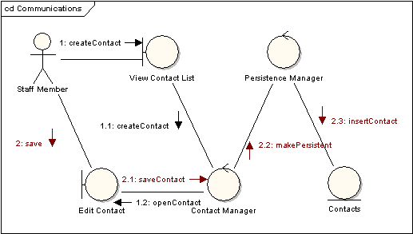
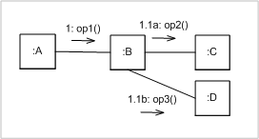
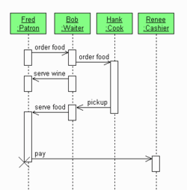
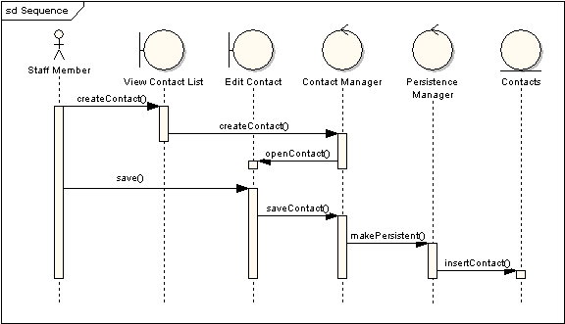
7.2 Some related concepts
Examples
Communication
Diagram
Equivalent
Sequence
Diagram

Slide 6
7.2 Some related concepts
Message
  A message is a specification of a communication between objects that conveys information with the expectation that activity will ensue
Roles
  Represents prototypical instances of classes, interfaces, components, nodes, and use cases.
  Their dynamic aspects are visualized, specified, constructed, and documented as flows of control.
Link
  A link is a semantic connection among objects. → an instance of an association
Connector → a prototypical link

Slide 7
7.2 Some related concepts
message
Sequence number
1.1: getLastCheckpoint()
1: getPositionAtTime(t)
t: AirTrafficPlanner
p: FlightPlan
link

Slide 8
7.2 Some related concepts
class
class
association
Person
1…*
*
Company
employee
employer
+ setCompensation(s:Salary)
+assign(task:String)
……
operation
message
Assign(task)
p: Person
:Company
connector
named role
anonymous role
Message instance
Assign(“AC current”)
Charles Steinmetz: Person
GE : Company
link
object
object

Slide 9
7.2 Some related concepts
In most models, prototyical objects and links within some context rather than individual objects and links is more interesting.
A link specifies a path which one object can dispatch a message to another(or the same) object.
It can be adorned at the appropriate end with the following constraints to be more precise about how that path exists
  Association: specify that the corresponding object is visible by association
  self: specify that the corresponding object is visible because it is the dispatcher of the operation
  global: specify that the corresponding object is visible because it is in an enclosing scope
  local: specify that the corresponding object is visible because it is in a local scope
  parameter: specify that the corresponding object is visible because it is a parameter

Slide 10
7.2 Some related concepts
Context
  (1) Interactions in the context of your system/subsystem
  Example: Web commerce system:
  instance of BookOrder and instance of OrderForm
  instance of BookOrder and instance of BackOrderManager
  (2) Interactions in the context of an operation
  Example: Mobile robot
  moveToPosition(p: Position) ← object current-Position
  (3) Interactions in the context of a class
  Example: A class RayTraceAgent
  Interaction among the attributes of its own
  Interaction with objects global to instance of the class

Slide 11
7.3 Sequence Diagram
对象
Definition (Rumbaugh):shows how objects communicate with each other in terms of a sequence of messages. Also indicates the lifespans of objects relative to those messages.
It is a 2D diagram: Parallel vertical lines (lifelines)→different processes or objects that live simultaneously; Horizontal arrows→ messages exchanged between them, in the order in which they occur.
An important characteristic of a sequence diagram is that time passes from top to bottom: the interaction starts near the top of the diagram and ends at the bottom

Slide 12
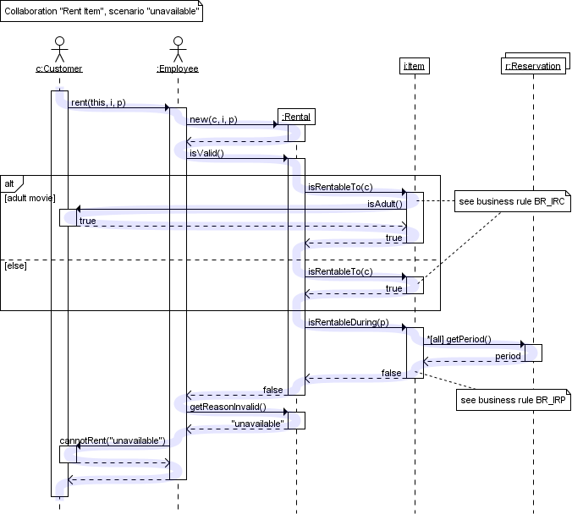

Slide 13
Four basic modeling elements：
  Objects
  Lifeline
  Focus of control, FOC
  Message
object
:Driver
message
:Car
1: oper()
Lifeline
FOC
Sequence diagram

Slide 14
7.2.1 Objects
Naming mode
  Including object name and class name
  Only including class name, not object name
  Only including object name, not class name
objectName:ClassName
:ClassName
objectName
When should an object be named?
You want to refer to it during the interaction as a message parameter or return value
You don't mention its type
There are other anonymous objects of the same type and giving them names is the only way to differentiate them

Slide 15
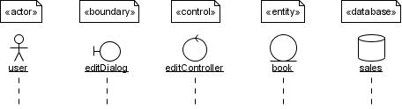


7.2.1 Objects
Besides the objects instanced from class, other stereotypes can used for objects: «actor», «boundary», «control», «entity» and «database».
Try to avoid long but non-descriptive names when you're also specifying the type of the object →Don't use 'aStudent' for an instance of type Student)
MultiObject
Class as the object

Slide 16
7.2.2 Lifeline and Focus of Control(FOC)
Lifeline →
  Rendered as dotted line
  Extends down the vertical axis from the base of each object.
  The lifeline indicates the life span of an object over a period of time.
FOC：
  Rendered as a thin, rectangular object that sits on top of object lifelines.
  To show the period of time during which an object performs an action.
  The top and bottom of the FOC rectangle coincides with the receipt of a message and the completion of an action and can be marked with a return message.
  FOC can be nested to more exactly indicate the beginning & end position of the message
Notes:
Option菜单注意

Slide 17
object1:C1 : v
v
v
object2:C2 :
object3:C3 :
1. oper1()
1.1. oper2()
1.1.1. oper3()
Nested FOC

Slide 18
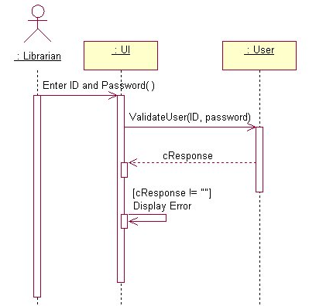
7.3 Messages in Sequence diagram
The most important elements of a sequence diagram
Indicate when one object calls an operation on another object (or itself). They are also used to indicate return values. Message flow begins at the top left object (which is usually an actor) and flows down the vertical axis from one object to another
When a message is sent to an object, the text associated with the message specifies the name of the method that is being called on the receiving object.
Note: When you add a message to a sequence diagram, most modeling tools automatically add a corresponding operation to the class that receives the message.

Slide 19
7.3.1 Message types in Sequence diagram
procedure call –
Synchronous message
asynchronous message
return message
simple message
balking message
time-out message
After UML1.4
Before UML1.3
In Rose

Slide 20
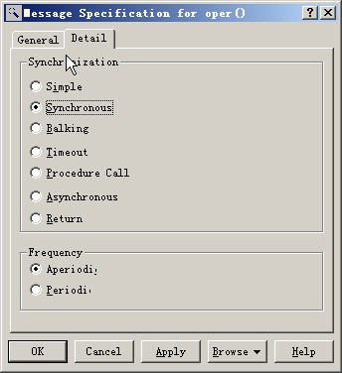
7.3.1 Procedure call – synchronous message
Used when the sender waits and do nothing until the receiver has finished processing the message, only then does the caller continue (i.e. a blocking call).
Similar as method calls in object-oriented programming languages
Rendered as a closed and filled arrowhead
:Driver
:Car
:Driver
:Car
oper()
oper()
Procedure call
Procedure call

Slide 21
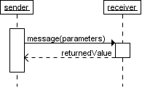
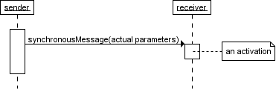
The white rectangles on a lifeline are called activations and indicate that an object is responding to a message. It starts when the message is received and ends when the object is done handling the message.
The receiver is a passive object：Need a message to drive to execute an action
If you want your diagrams to be easy to read, only show the return arrow if a value is returned. Otherwise, hide it.

Slide 22
7.3.2 Asynchronous & Simple message
  The sender does not wait for the receiver to finish processing the message, it continues immediately.
  Examples: Messages sent to a receiver in another process or calls that start a new thread.
Once the message is received, both sender and receiver are working simultaneously.
  However, showing two simultaneous flows of control on one diagram is difficult. Usually authors only show one of them, or show one after the other.
The sign for simple message of UML1.3 and before is the same as the sign for asynchronous message of UML 1.4 and after. → half-arrow ( the same as that in rose2003)

Slide 23
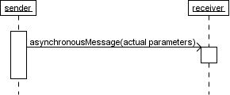
:Driver
:Car
oper()
Asynchronous message

Slide 24
7.3.3 Return message
Represent returning from procedure call
The return message is implicit, can be hidden
For non-procedure call, if there is return message, it should be drawn
:Driver
:Car
oper()
Return message

Slide 25
7.3.4 Balking message
Firstly, the sender sent a message to the receiver → The sender abandons the message if the receiver is not ready to accept it.
Rendered as an retraced arrow in Rose
:Driver
:Car
oper()
Balking message

Slide 26
7.3.5 Timeout message
The sender send a message to the receiver and will wait for a specified time.
  The sender will abandon the message if the it can’t receive return message within the specified time
:Driver
:Car
oper()
Timeout message

Slide 27
7.3.6 Message Syntax
[predecessor] [guard-condition] [message-expression] [return-value := ]
message-name ([argument-list])
Predecessor: the list of messages that must occur in advance.
  The messages are separated by comma ‘,’
  Represented as: Sequence-number ‘,’ … ‘/’
Guard-condition: only the guard-condition is satisfied, the message can be sent.
  ‘[ ’ Boolean-expression ‘]’
Message-expression:
  The sign ‘.’ is used to separate different sequence-terms;
  Colon ‘:’ is used to mark the end of message
  An example: sequence-term ‘.’…‘:’

Slide 28
7.3.6 Message Syntax
Sequence-term
  [integer | name ] [ recurrence ]
  Integer → message No. //// name → concurrent control thread
  An example: 3.1a & 3.1b are two concurrent message in activation 3.1
Recurrence is used to represent conditional execution or recurrent execution
  ‘*’ [ ‘[‘iteration-clause’]’] → recurrent sending
  ‘[‘condition-clause’]’ → conditional sending
  An example: * [i :=1…n] /// [x>y]
Return-value：the parameter name list to be given the returned value of the message
Message-name: the imperative part in a message
Argument-list

Slide 29
7.3.6 Message Syntax – some examples
2: display(x,y) Simple message
1.3.1: p := find(specs) Nested message with return message
[x<0] 4: invert(x,color) Conditional message
3.1 *: update() Recurrent message
A3,B4/C2:copy(a,b) Synchronization between threads

Slide 30
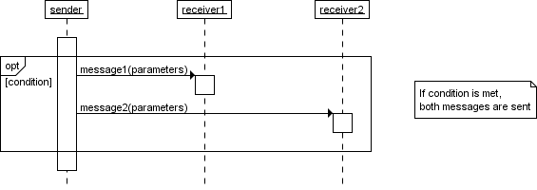
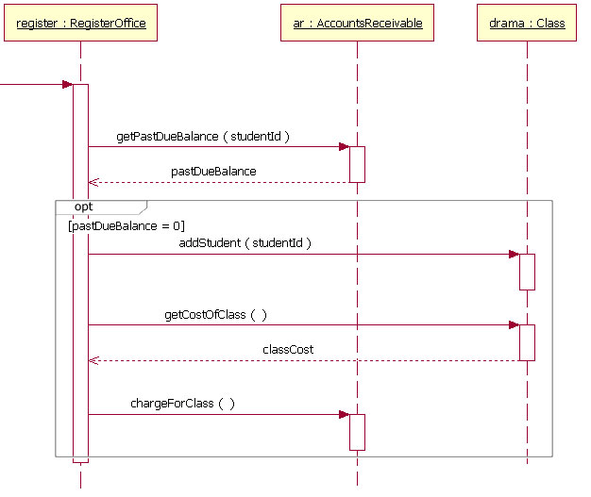
7.3.7 Combined fragments--Opt
several messages are conditionally sent under the same guard, you'll have to use an 'opt' combined fragment

Slide 31
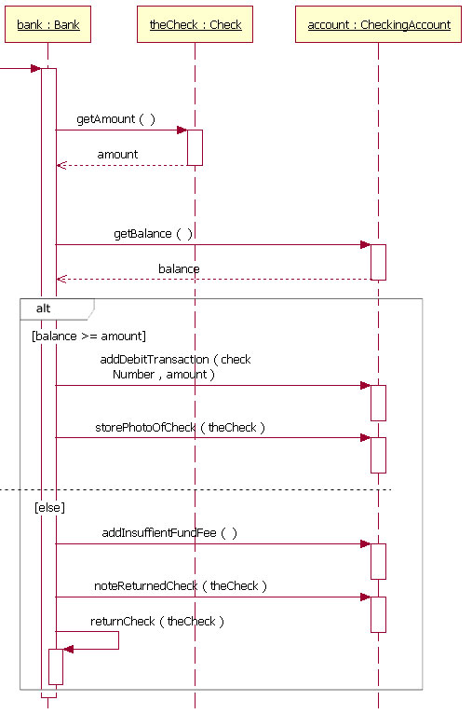
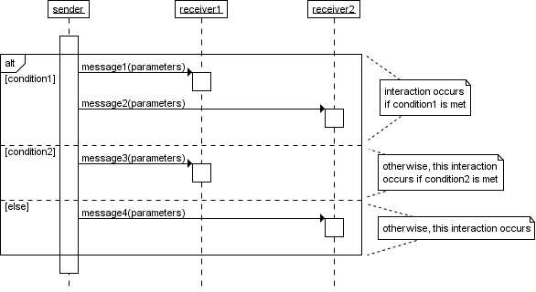
7.3.7 Combined fragments -- Alt
several alternative interactions, use an 'alt' combined fragment. The combined fragment contains an operand for each alternative. Each alternative has a guard and contains the interaction that occurs when the condition for that guard is met.

Slide 32
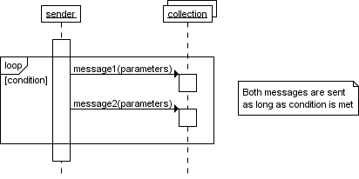
7.3.7 Combined fragments -- Loop
multiple messages are sent in the same iteration, a ‘loop’ combined fragment can be used. The operator of the combined fragment is ‘loop’ and the guard represents the condition to control the repetition.
What difference between Loop and Option?
Notes:
The loop combination fragment is very similar in appearance to the option combination fragment. You draw a frame, and in the frame's namebox the text "loop" is placed. Inside the frame's content area the loop's guard is placed towards the top left corner, on top of a lifeline. [Note: As with the option combination fragment, the loop combination fragment does not require that a guard condition be placed on it.] Then the loop's sequence of messages is placed in the remainder of the frame's content area. In a loop, a guard can have two special conditions tested against in addition to the standard Boolean test. The special guard conditions are minimum iterations written as "minint = [the number]" (e.g., "minint = 1") and maximum iterations written as "maxint = [the number]" (e.g., "maxint = 5"). With a minimum iterations guard, the loop must execute at least the number of times indicated, whereas with a maximum iterations guard the number of loop executions cannot exceed the number

Slide 33
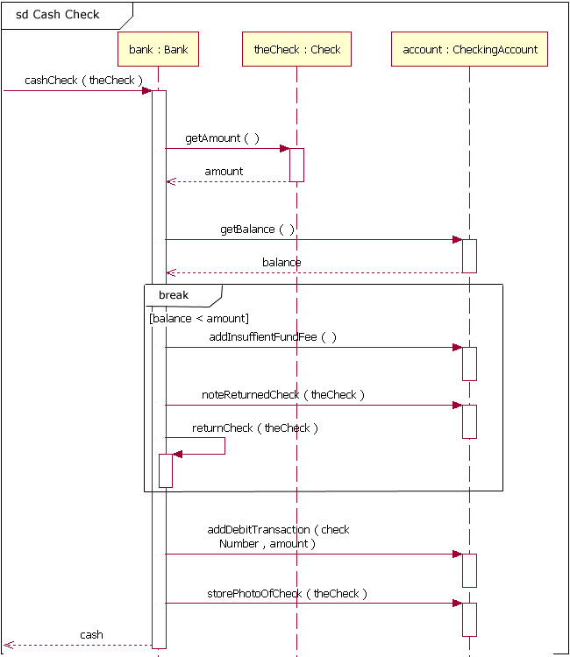
7.3.7 Combined fragments -- Break
Notes:
The break combined fragment is almost identical in every way to the option combined fragment, with two exceptions. First, a break's frame has a namebox with the text "break" instead of "option." Second, when a break combined fragment's message is to be executed, the enclosing interaction's remainder messages will not be executed because the sequence breaks out of the enclosing interaction. In this way the break combined fragment is much like the break keyword in a programming language like C++ or Java.

Slide 34
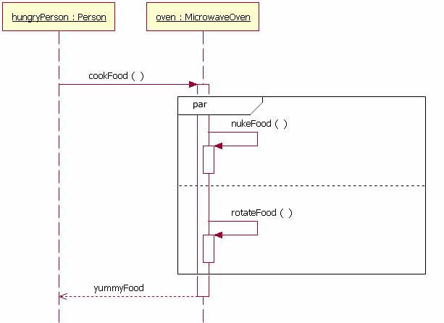
7.3.7 Combined fragments -- Parallel
A microwave doing two tasks in parallel
Notes:
Parallel
Today's modern computer systems are advancing in complexity and at times perform concurrent tasks. When the processing time required to complete portions of a complex task is longer than desired, some systems handle parts of the processing in parallel. The parallel combination fragment element needs to be used when creating a sequence diagram that shows parallel processing activities.
The parallel combination fragment is drawn using a frame, and you place the text "par" in the frame's namebox. You then break up the frame's content section into horizontal operands separated by a dashed line. Each operand in the frame represents a thread of execution done in parallel.

Slide 35
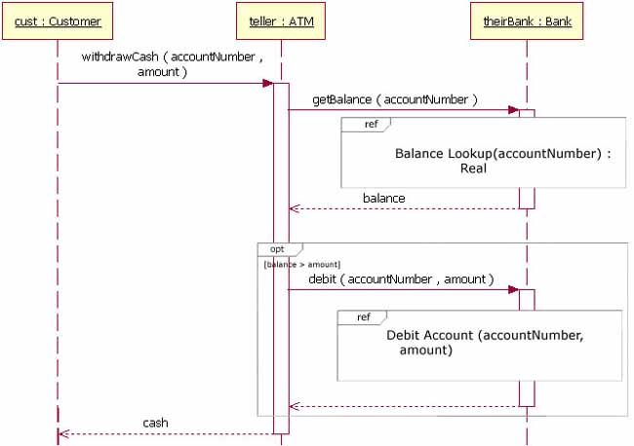
7.3.8 Beyond the basics – reference another sequence diagram
The addition of interaction occurrences is arguably the most important innovation in UML 2 interactions modeling
  Interaction occurrences add the ability to compose primitive sequence diagrams into complex sequence diagrams
Syntax: sequence diagram name[(arguments)] [: return value]
Two examples
Retrieve Borrower Credit Report(ssn) : borrowerCreditReport
Process Credit Card(name, number, expirationDate, amount : 100)
Notes:
When doing sequence diagrams, developers love to reuse existing sequence diagrams in their diagram's sequences. [Note: It is possible to reuse a sequence diagram of any type (e.g., programming or business). I just find that developers like to functionally break down their diagrams more.] Starting in UML 2, the "Interaction Occurrence" element was introduced. The addition of interaction occurrences is arguably the most important innovation in UML 2 interactions modeling. Interaction occurrences add the ability to compose primitive sequence diagrams into complex sequence diagrams. With these you can combine (reuse) the simpler sequences to produce more complex sequences. This means that you can abstract out a complete, and possibly complex, sequence as a single conceptual unit.
An interaction occurrence element is drawn using a frame. The text "ref" is placed inside the frame's namebox, and the name of the sequence diagram being referenced is placed inside the frame's content area along with any parameters to the sequence diagram. The notation of the referenced sequence diagram's name follows the pattern of:
sequence diagram name[(arguments)] [: return value]
Two examples:
1. Retrieve Borrower Credit Report(ssn) : borrowerCreditReport
or
2. Process Credit Card(name, number, expirationDate, amount : 100)
In example 1, the syntax calls the sequence diagram called Retrieve Borrower Credit Report and passes it the parameter ssn. The Retreive Borrower Credit Report sequence returns the variable borrowerCreditReport.
In example 2, the syntax calls the sequence diagram called Process Credit Card and passes it the parameters of name, number, expiration date, and amount. However, in example 2 the amount parameter will be a value of 100. And since example 2 does not have a return value labeled, the sequence does not return a value (presumably, the sequence being modeled does not need the return value).

Slide 36
7.3.8 Steps for building sequence diagram
Determine the context of interaction
Identify the objects participating in interaction
Set up the lifeline for each object: determine which objects exist in the whole interaction and which objects are create and deleted during the interaction
Beginning from the initial message starting the interaction, drawing all the messages from top to down between the lifelines
If it is necessary to represent nested message and/or the exact time, FOC is used
To illustrate the time constraint, the comments can be used near the message
Prepositive and postpositive conditions can be added for each message
Notes:
指导原则，而非标准

Slide 37
7.4 Collaboration/communication diagram
Describes interactions among objects in terms of sequenced messages.
Unlike a sequence diagram, a collaboration diagram shows the relationships among the objects.
  Describe how the system behavior is realized by collaboration of system’s components
Modeling elements: object, message, link, etc.
Link: used to connect the objects in collaboration diagram
  Message are shown near the link, and one link can have more than one messages
Free-form arrangement of objects and links are used in collaboration diagrams. In order to maintain the ordering, messages are labeled with a chronological number. Reading a communication diagram involves starting at message 1.0, and following the messages from object to object.

Slide 38
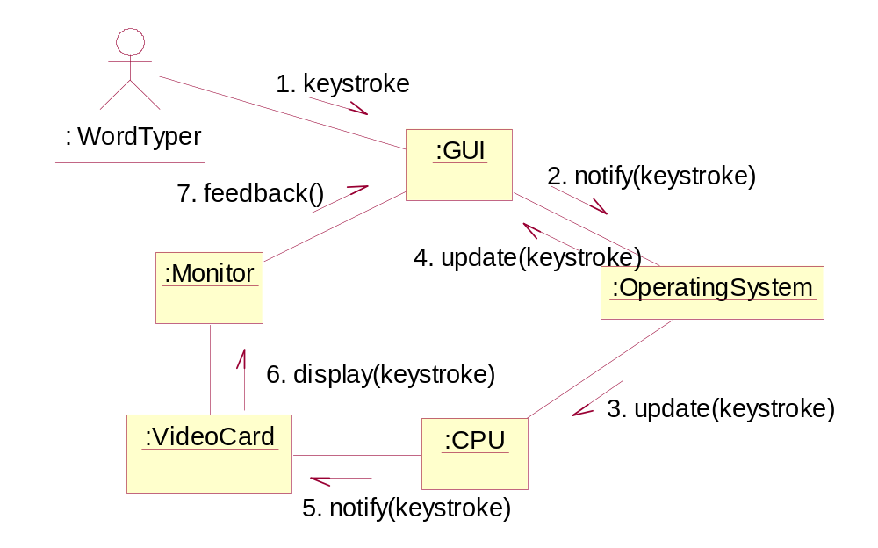
7.4 Collaboration/communication diagram

Slide 39
7.4.1 Link
Link —— special elements of collaboration diagram
  Is the instance of association
  When there is association between two class, there must be link between their instances. And, the message can be sent from one object to another
  Association is permanent whereas the link is temporary.
  Some adornments can be added on the link, such as role name, navigation(unidirectional / bidirectional)
  Cannot be of multiplicity!!!

Slide 40
7.4.2 Steps for building collaboration diagram
Determine the context of interaction
Identify the objects participating in interaction
Set up the initial values for each object if necessary
Determine the links between objects and the messages on the links
Starting from the message initiating the whole interaction process, attach the messages to the corresponding links
Prepositive and postpositive conditions can be added for each message if necessary
Notes:
指导性原则

Slide 41
7.5 Comparison of sequence diagram and collaboration diagram
Belong to interaction diagram, used to describe the dynamic relationship between the objects of a system
Can be converted each other, but have different focuses:
  For sequence diagram, the focus is time or sequence of the message
  For collaboration diagram, the focus is the context of the objects that participate in interaction
Modeling elements are different
  There are lifeline and FOC for sequence diagram
  There are link for collaboration diagram. And the message should have corresponding serial number

Slide 42
7.6 Common problems
How to represent the following things in sequence diagram:
  Recurrent sending of message
  Conditional sending of message
  Time constraint
  Recursive call of the methods
How to determine the objects of sequence diagram?
Is it necessary to generate sequence diagram and class diagram simultaneously and modify them interactively?
If the object has multiplicity, the sender cannot determine which class the target object belongs to in advance. So, how to determine the class of the target object in interaction diagram?
How to represent broadcasting message in interaction diagram?
Notes:
循环、条件：直接通过消息表达，或者通过注释表示
时间：通过注释表示，如：两条消息的时间间隔
递归调用：自己调用自己，注意option菜单里面的内容
对象确定：初始类图->顺序图->详细类图
多态性：类抽象，写对象名，不写类名
广播消息：接收者抽象，写类名，不写对象名

Slide 43
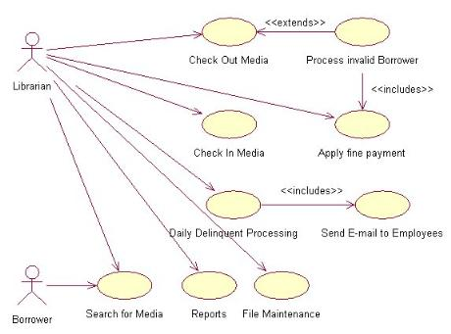
7.7 Example
Create a sequence diagram to model the logic of a use case.
  in-house technical library

Slide 44
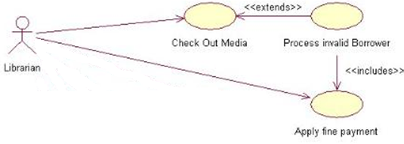
7.7 Example
Step 1: select a use case and give description
The actor (in this case, the Librarian) navigates to the "Check Out Media" form and enters the borrower's ID
The system responds by validating the borrower (no overdue media, outstanding fines less than $100, and no more than five items checked out)
If the borrower is invalid, the system displays a warning message and the use case scenario ends here
If the borrower is valid, the actor enters the media ID
The system responds by marking the media as “checked out” for the specified borrower

Slide 45
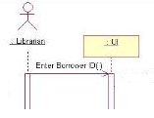
7.7 Example
Step 2: Add the Actor, UI Objects and Use Case Text
  Each use case is carried out by an actor (signifying a specific type of user). This step simply involves adding the appropriate actor and a UI class to the sequence diagram
  Can create a single UI placeholder class to represent all interaction with the user interface, or you can create a different class for each user interface element. In either case, the appropriate user interface class needs to be added to the sequence diagram.
  Add a message between the actor and the UI that indicates the action taken by the user → "Enter Borrower ID”
  Adding notes to help others understand your diagram

Slide 46
7.7 Example
Step 3: Select Classes to Carry out the System Response
  Examine each step of the use case and add the appropriate classes to the diagram. This may take a bit of thought, because it may not be readily apparent which class you should choose to carry out each responsibility→ the Transaction and Fine objects are created to carry out step 2 of the use case.

Slide 47
7.7 Example
Step 4: Add Messages Between Objects
  To carry out each step of the use case. This includes both message calls and, optionally, return values.
  CalcAmtCanBorrow() → Can or not borrow?
    CalcBorrowersFine(bID)
    GetBorrowersCheckedOutMedia(bID)
    IsMediaOverdue(mID)
  If cannot borrow → Display invalid message()
  If OK, CheckOut(bID, mID,ckoutDate()
    <<create>> (:Media)
    CheckOut(mID)

Slide 48
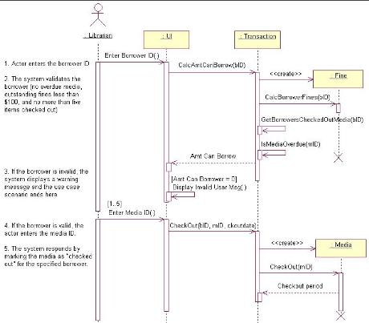
7.7 Example

Slide 49
7.8 Conclusion
Sequence diagram and collaboration diagram are both interaction diagram → dynamic modeling part
Sequence diagram has the focus on the sequence of events
Collaboration diagram has the focus on context
The modeling elements for sequence diagram are object, lifeline, FOC and message, etc.
The modeling elements for collaboration diagram are object, message, link, etc.
The message in interaction diagram can be divided into procedure message, asynchronous message and return message
  Some more message can also be represented
There is no standard for building sequence diagram and collaboration diagram→ only some guiding principles
Currently the UML tools can support the modeling of interaction diagram. However, most of the don’t support forward engineering and reverse engineering

